Slide 1
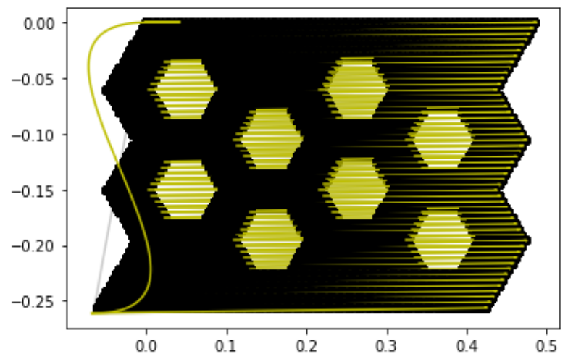
Part 1 (Ns)
Code start
Unit Cell 1
Unit Cell 2
Part 2 (Nh)
Unit Cell 4
Part 3 (Ns)
Unit Cell 3
Part 4 (Nh)
Part 5 (Ns)
Part 6 (Nh)
End Cap
Part 7 (Ns)

